Slide 1
COMPUTER ORGANIZATION AND ARCHITECTURE
SYLLABUS and SCHEME

Slide 2
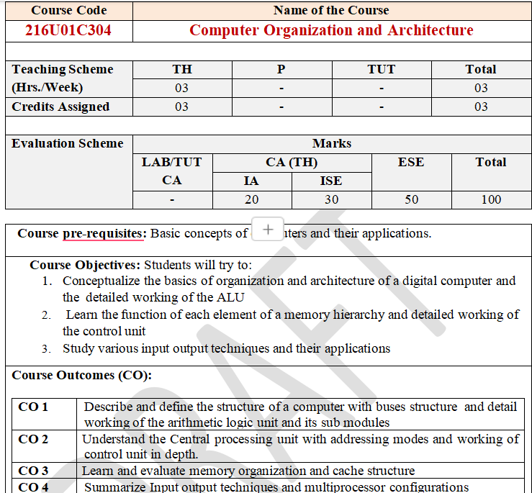

Slide 3
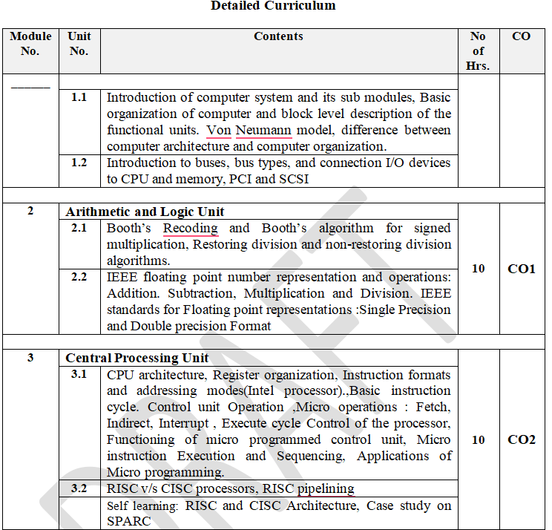

Slide 4
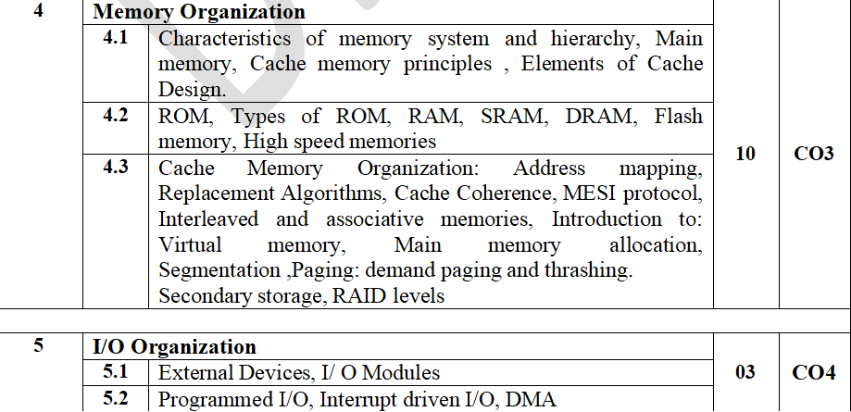

Slide 5
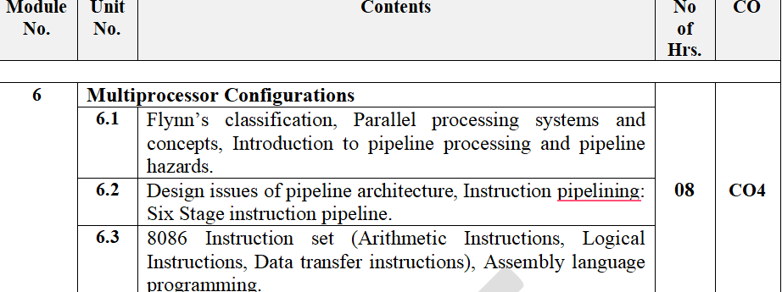

Slide 6
Sr. No. | Name/s of Author/s | Title of Book | Name of Publisher with country | Edition and Year of Publication
1. | W.Stallings William | Computer Organization and Architecture: Designing for Performance | Pearson Prentice Hall Publication | 7th Edition
2. | Hamacher, V. Zvonko, S. Zaky | Computer Organization | Tata McGraw Hill Publication | 5th Edition
3. | Hwang and Briggs | Computer Architecture and Parallel Processing | Tata McGraw Hill Publication
4. | A. Tanenbaum | Structured Computer Organization | Prentice Hall Publication | 4th Edition.
5. | John Uffenbeck | 8086/8088 families: Design Programming and Interfacing | Pearson Education
6. | Douglas Hall | Microprocessor and Interfacing | TMH Publication

Slide 7
William Stallings Computer Organization and Architecture
Chapter 1 Introduction

Slide 8
Architecture & Organization
Architecture is those attributes visible to the programmer
Instruction set, number of bits used for data representation, I/O mechanisms, addressing techniques.
Organization is how features are implemented
Control signals, interfaces, memory technology.
e.g. Is there a hardware multiply unit or is it done by repeated addition?

Slide 9
COMPUTER ARCHITECTURE | COMPUTER ORGANIZATION
Way hardware components are connected together to form a computer system. | Structure and behaviour of a computer system as seen by the user.
It acts as the interface between hardware and software. | It deals with the components of a connection in a system.
Helps us to understand the functionalities of a system. | How exactly all the units in the system are arranged and interconnected.
A programmer can view architecture in terms of instructions, addressing modes and registers. | Whereas Organization expresses the realization of architecture.
While designing a computer system architecture is considered first. | An organization is done on the basis of architecture.
Computer Architecture deals with high-level design issues. | Computer Organization deals with low-level design issues.
Architecture involves Logic (Instruction sets, Addressing modes, Data types, Cache optimization) | Organization involves Physical Components (Circuit design, Adders, Signals, Peripherals)

Slide 10
Architecture & Organization
All Intel x86 family share the same basic architecture
The IBM System/370 family share the same basic architecture
This gives code compatibility
At least backwards
Organization differs between different versions

Slide 11
S.NO | Processor | Clock Speed | Bus Width | MIPS | Power | Price
1 | Intel Pentium 111 | The clock speed of Intel Pentium 111 processor is 1GHz | The bus width of Intel Pentium 111 processor is 32 | A million instructions per second of Intel Pentium 111 processor is ~900 | The power of this processor is 97 W | $900
2 | IBM PowerPC 750X | The clock speed of the IBM PowerPC 750X processor is 550 MHz | The bus width of the IBM PowerPC 750X processor is 32/64 | A million instructions per second of IBM PowerPC 750X processor is ~1300 | The power of this processor is 5 W | #900
3 | MIPS R5000 | The clock speed of the MIPS R5000 processor is 250 MHz | The bus width of the MIPS R5000 processor is 32/64 | NA | NA | NA
4 | StrongARM SA-110 | The clock speed of StrongARM SA-110 processor is 233 MHz | The bus width of StrongARM SA-110processor is 32 | The million instructions per second of StrongARM SA-110processor is 268 | The power of this processor is 1 W | NA

Slide 12
Structure & Function
Structure is the way in which components relate to each other
Function is the operation of individual components as part of the structure

Slide 13
Function
All computer functions are:
Data processing
Data storage
Data movement
Control

Slide 14
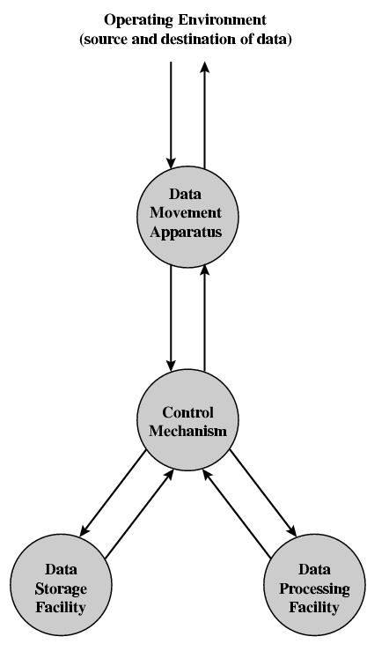
Functional View

Slide 15
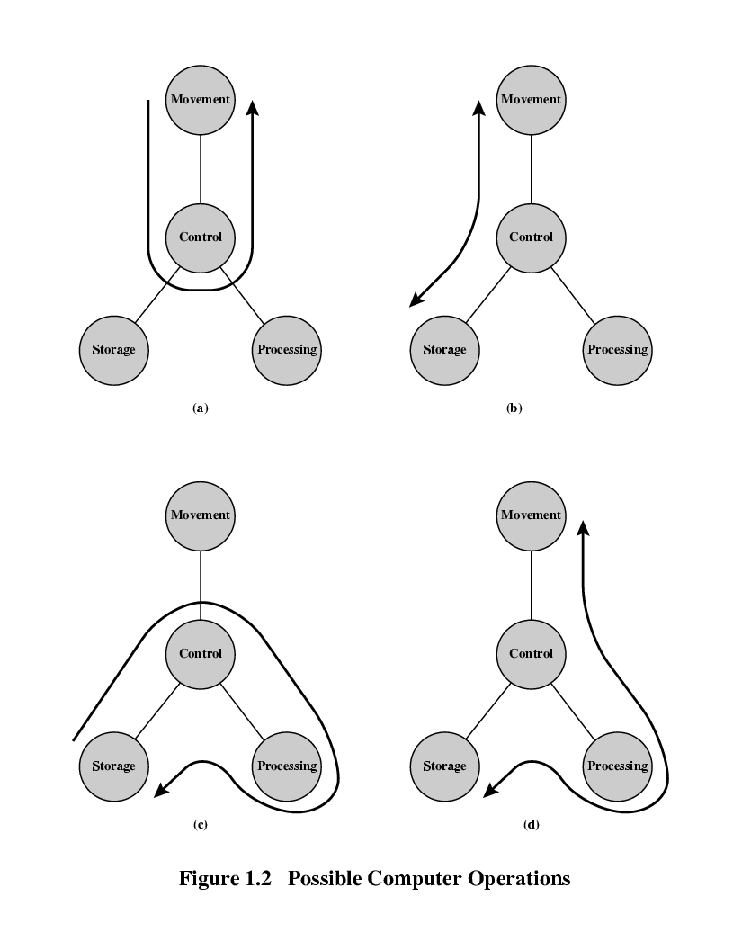
Operations (a) Data movement

Slide 16
Operations (b) Storage

Slide 17
Operation (c) Processing from/to storage

Slide 18
Operation (d) Processing from storage to I/O

Slide 19
Structure - Top Level
Peripherals
Computer
Central
Processing
Unit
Main
Memory
Computer
Systems
Interconnection
Input
Output
Communication
lines

Slide 20
Structure - The CPU
CPU
Computer
Arithmetic
and
Logic Unit
I/O
Registers
System
Bus
CPU
Internal CPU
Interconnection
Memory
Control
Unit

Slide 21
Structure - The Control Unit
Control Unit
CPU
ALU
Sequencing
Logic
Internal
Bus
Control
Unit
Control Unit
Registers and
Decoders
Registers
Control
Memory

Slide 22
William Stallings Computer Organization and Architecture 8th Edition
Chapter 2 Computer Evolution and Performance

Slide 23
Von Neumann
Stored Program concept
Main memory storing programs and data
ALU operating on binary data
Control unit interpreting instructions from memory and executing
Input and output equipment operated by control unit
Princeton Institute for Advanced Studies
IAS
Completed 1952

Slide 24
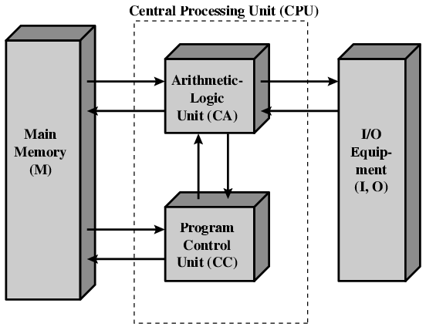
Structure of Von Neumann machine

Slide 25
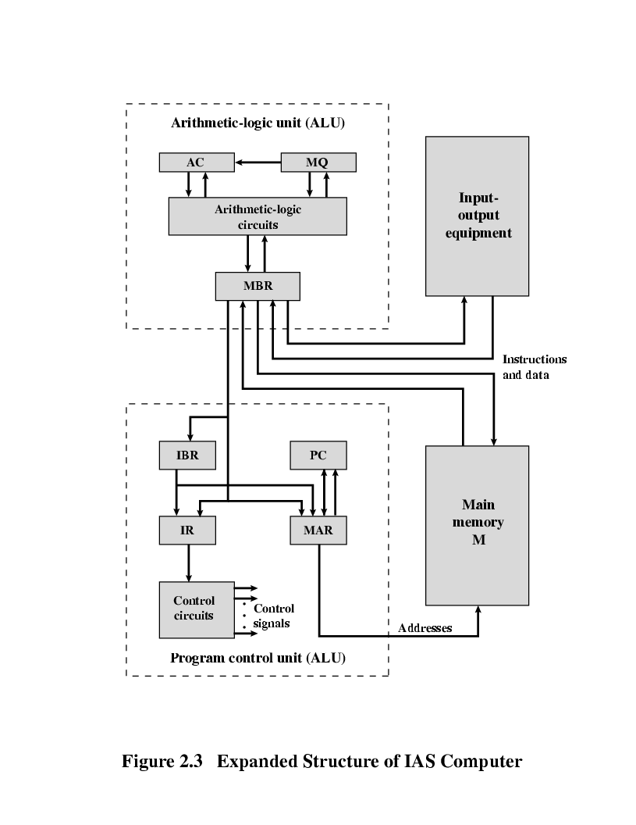
Structure of IAS – detail

Slide 26
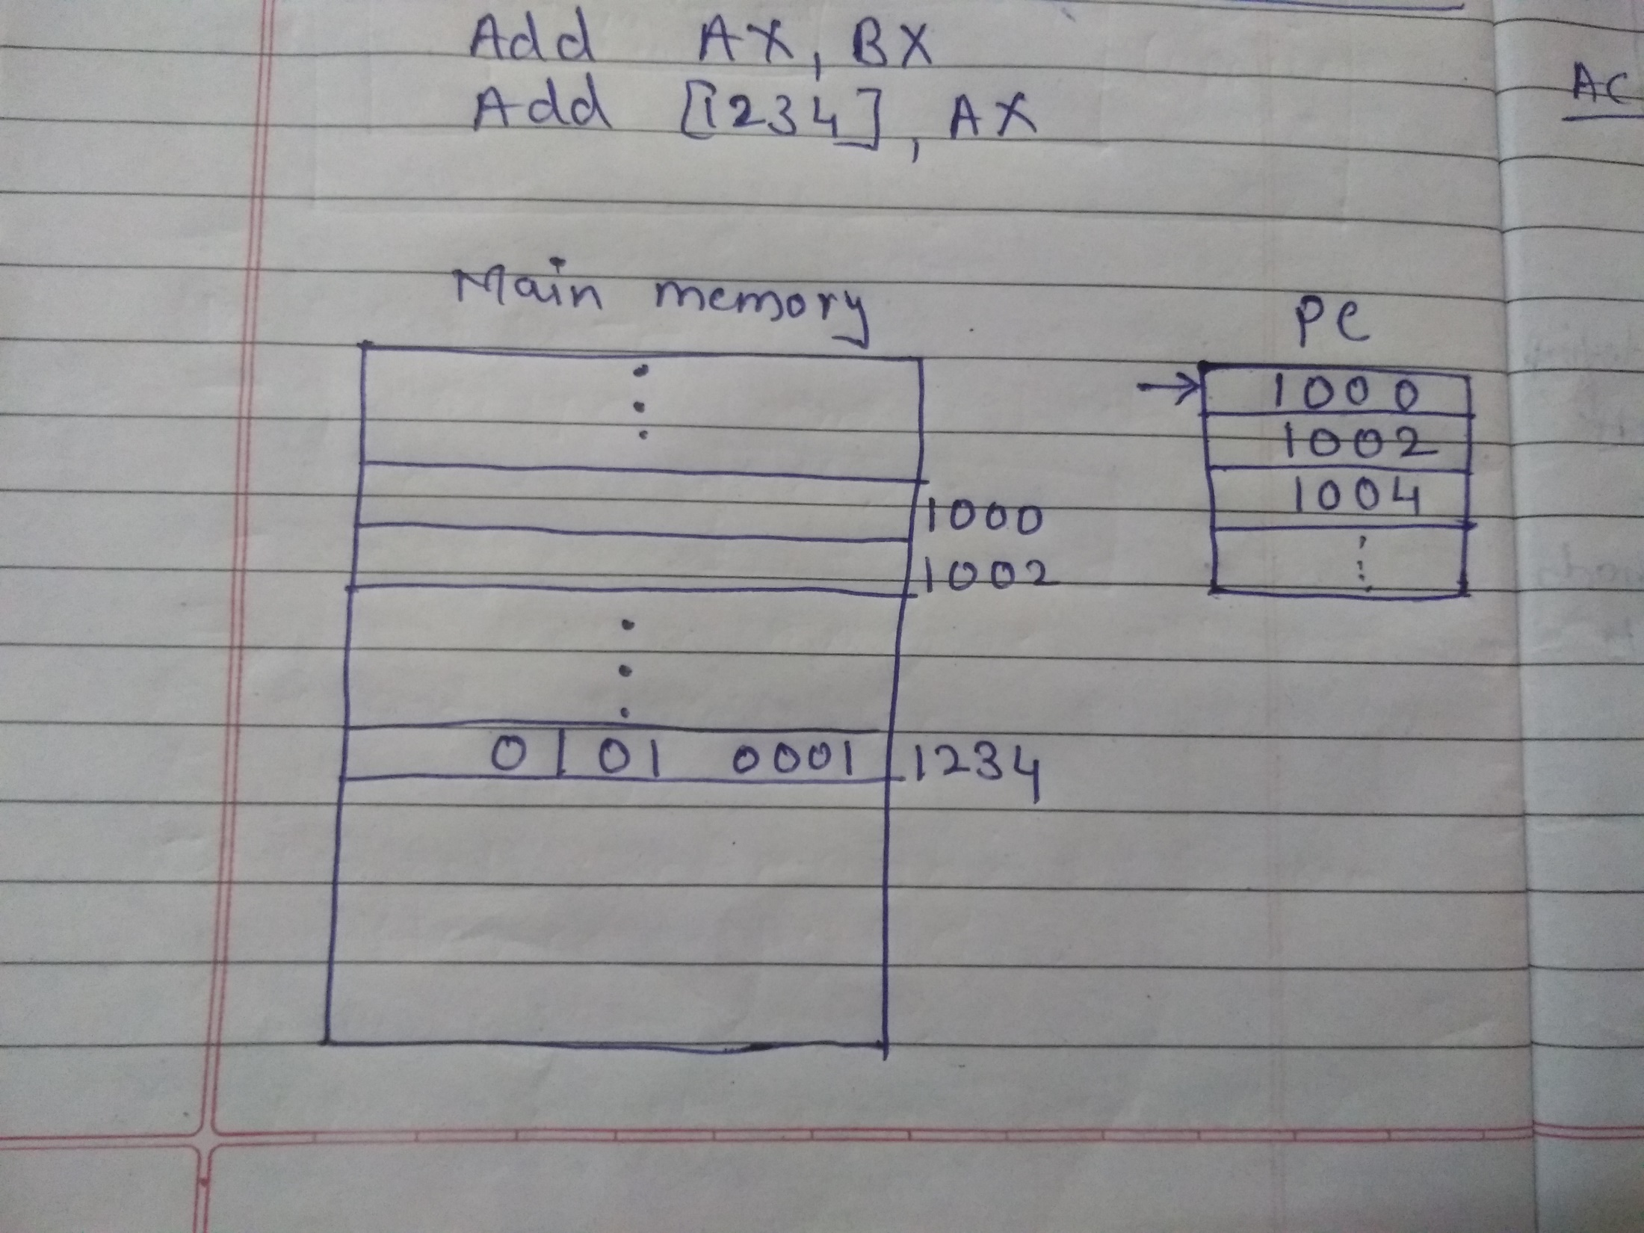
Structure of IAS – detail

Slide 27
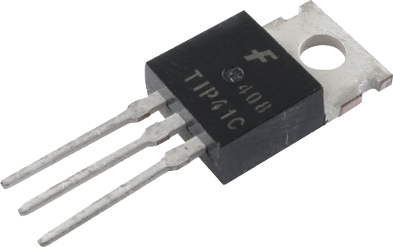
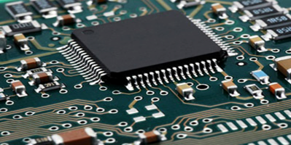
Generations of Computer
Vacuum tube - 1946-1957
Transistor - 1958-1964
Small scale integration - 1965
Up to 100 devices on a chip
Medium scale integration - to 1971
100-3,000 devices on a chip
Large scale integration - 1971-1977
3,000 - 100,000 devices on a chip
Very large scale integration - 1978 -1991
100,000 - 100,000,000 devices on a chip
Ultra large scale integration – 1991 -Over 100,000,000 devices on a chip

Slide 28
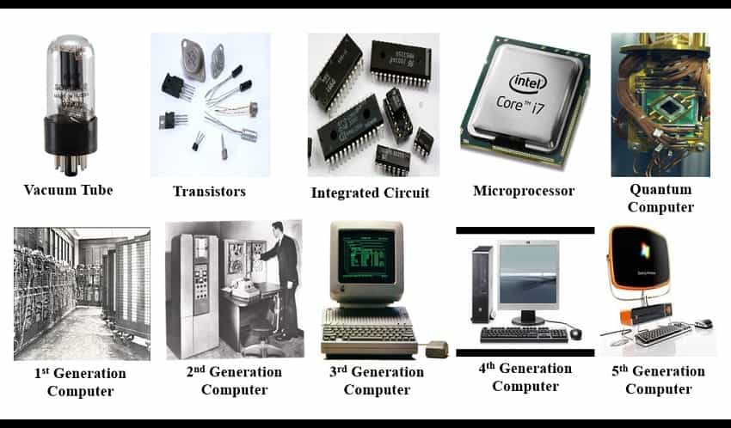

Slide 29
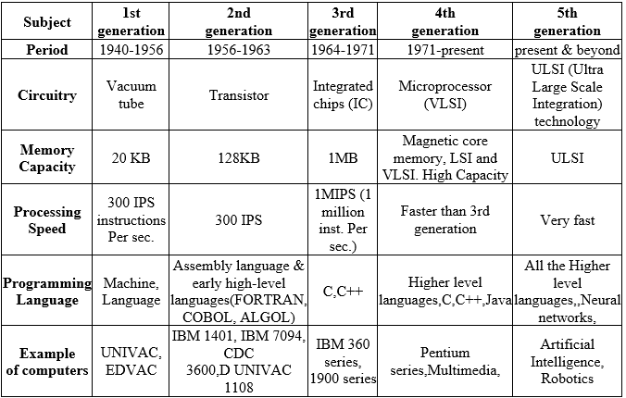

Slide 30
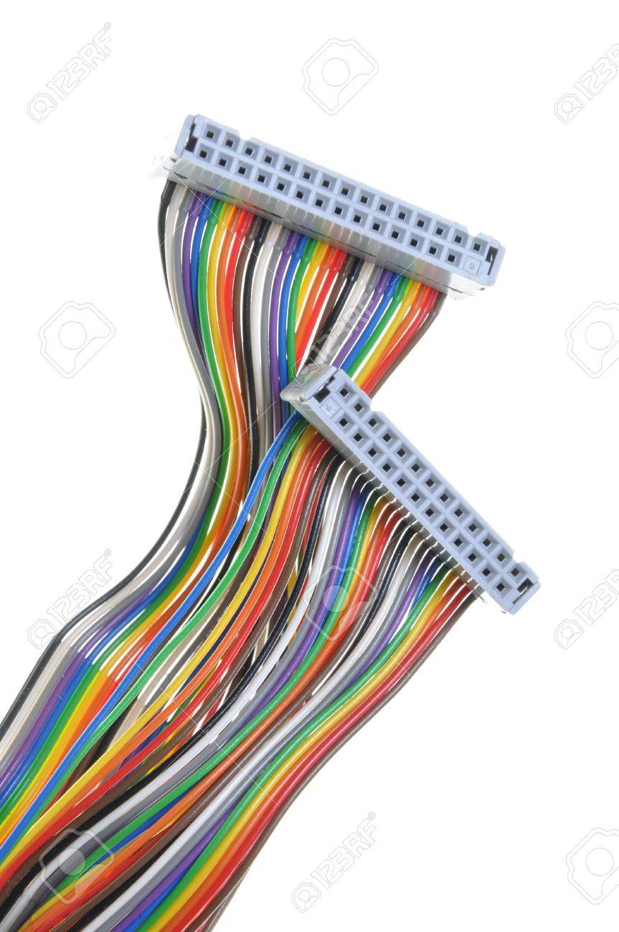
What is a Bus?
A communication pathway connecting two or more devices
Data connection between 2 or more devices connected to the computer
Usually broadcast ,Often grouped
For Ex: A bus enables a computer processor to communicate with the memory or video card to communicate with the memory
e.g. 32 bit data bus is 32 separate single bit channels
Power lines may not be shown

Slide 31
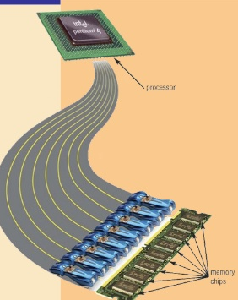
Buses
There are a number of possible interconnection systems
Single and multiple BUS structures are most common
e.g. Control/Address/Data bus (PC)
e.g. Unibus (DEC-PDP)

Slide 32
Functions of Buses in Computers
Data sharing - Serial/Parallel, 8-bit, 16-bit, 32-bit or even 64-bit buses.
Addressing - A bus has address lines which allows data to be sent to or from specific memory locations.
Power - A bus supplies power to various peripherals connected to it.
Timing - System clock-synchronize the peripherals attached to it with the rest of the system.
Eg: The expansion bus facilitates easy connection of more or additional components and devices on a computer such as a TV card or sound card.

Slide 33
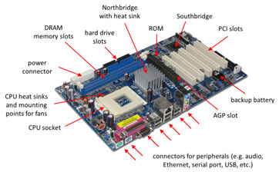
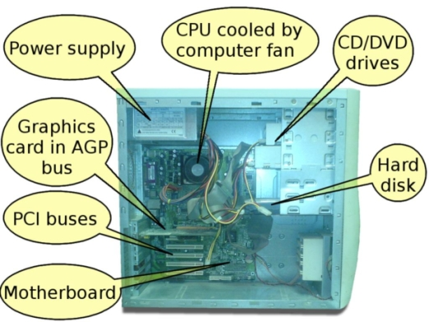
Notes:
Northbridge&Southbridge-The northbridge links the CPU to very high-speed devices, especially RAM and graphics controllers, and the southbridge connects to lower-speed peripheral buses (such as PCI or ISA)
AGP-Accelerated Graphics

Slide 34
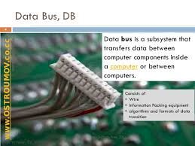
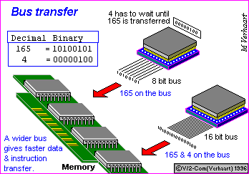
Data Bus
Carries data
Remember that there is no difference between “data” and “instruction” at this level
Width is a key determinant of performance
8, 16, 32, 64 bit

Slide 35
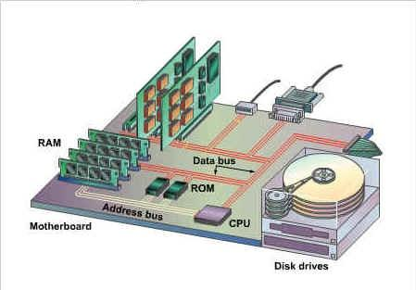
Address bus
Identify the source or destination of data
e.g. CPU needs to read an instruction (data) from a given location in memory
Bus width determines maximum memory capacity of system
2 ^nos of address lines=Memory Capacity
e.g. 8080 has 16 bit address bus giving 64k address space
32 bit?64bit ? 2 ^
(16.777216 million terabyte)

Slide 36
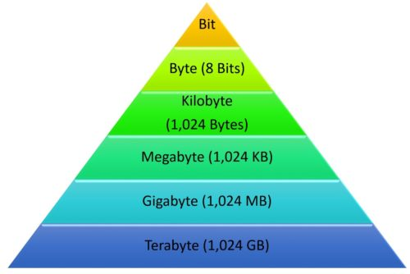
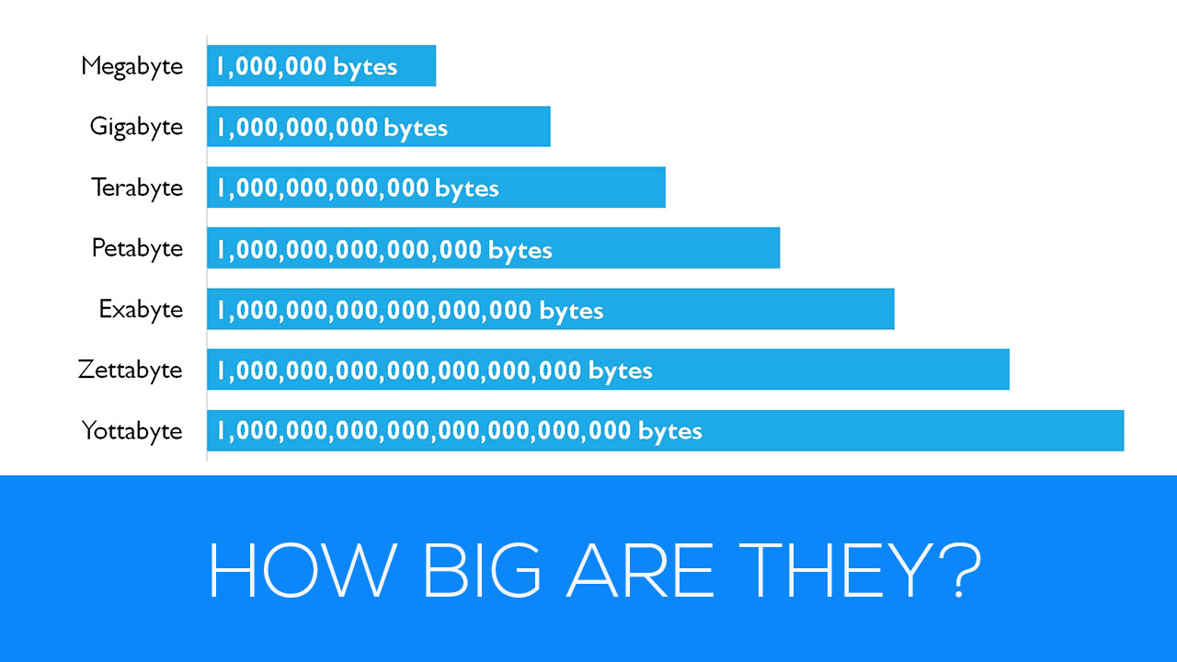

Slide 37
Control Bus
Controls activities of all units of a computer
Main Function is to carry control signals generated by control unit
Ex: One line of control bus is used to indicate whether the CPU is reading/writing to the main memory
Control and timing information
Memory read/write signal
Interrupt request
Clock signals

Slide 38
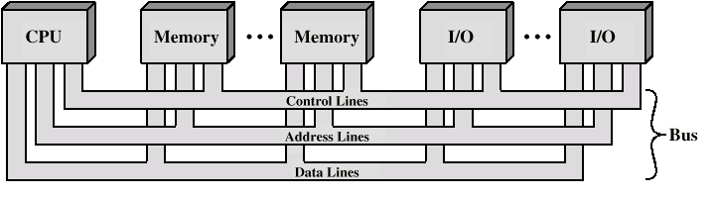
Bus Interconnection Scheme

Slide 39
Single Bus Problems
Lots of devices on one bus leads to:
Propagation delays
Long data paths mean that co-ordination of bus use can adversely affect performance
Most systems use multiple buses to overcome these problems

Slide 40
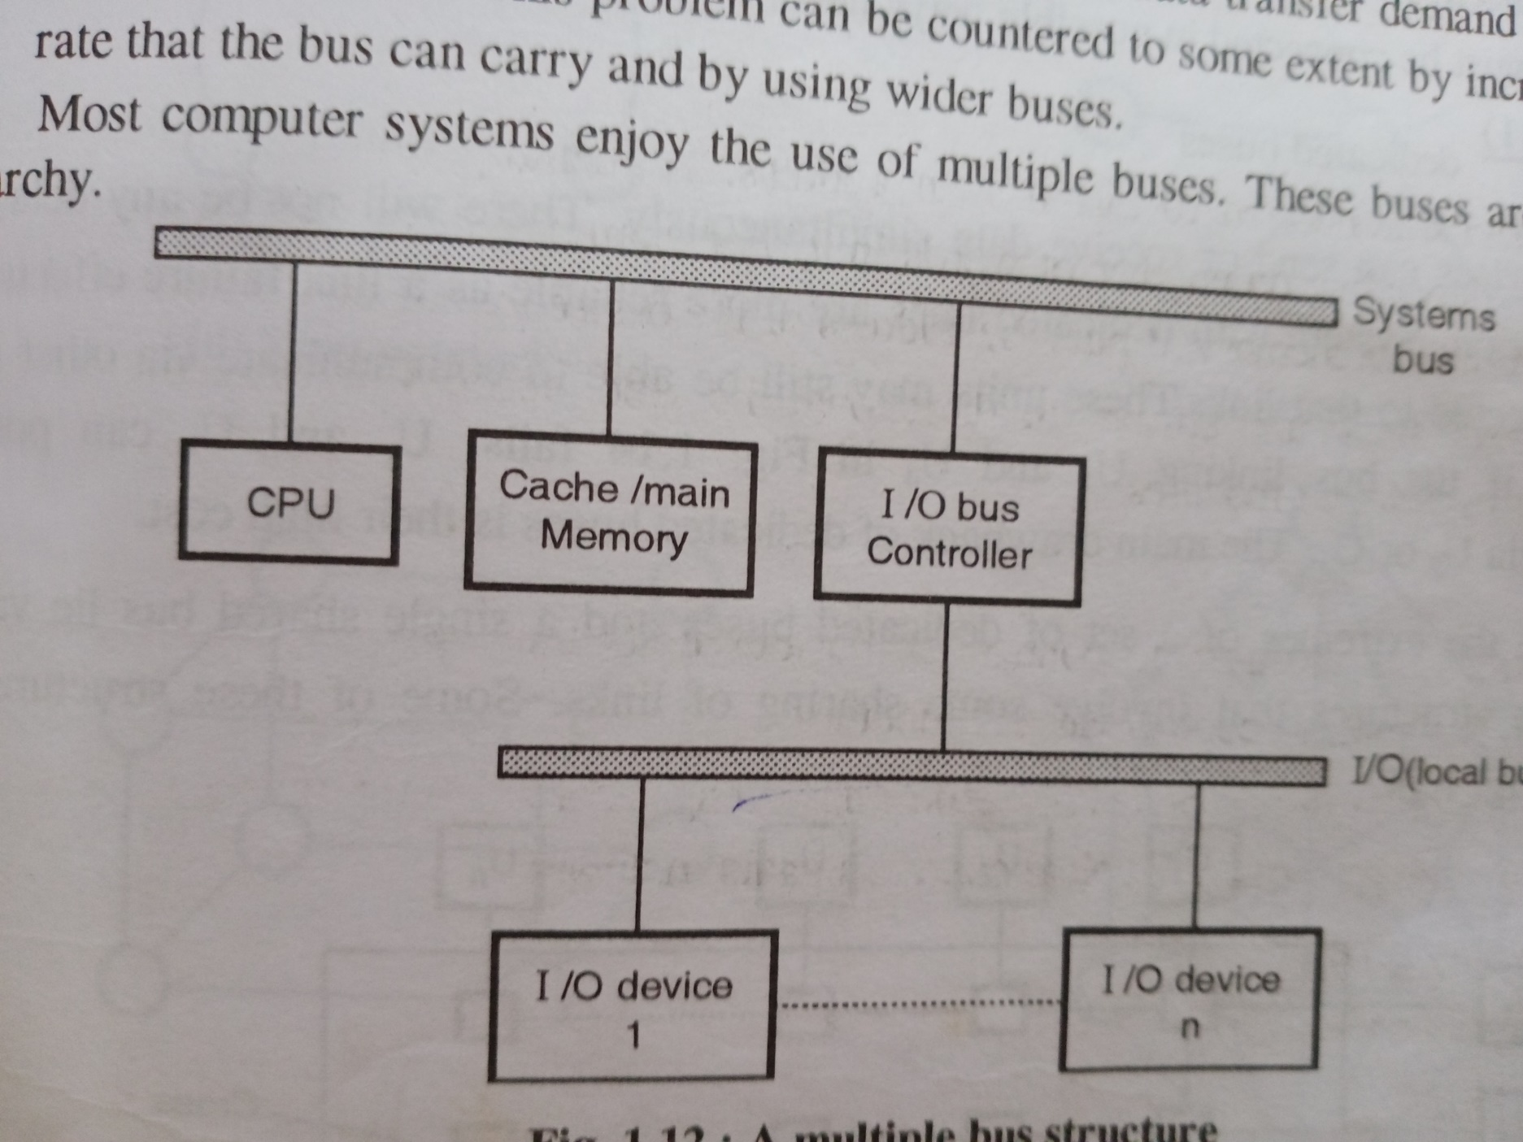
Multiple Bus

Slide 41
Bus Types
Dedicated
Separate data & address lines
Multiplexed
Shared lines
Address valid or data valid control line
Advantage - fewer lines
Disadvantages
More complex control
Ultimate performance

Slide 42
Bus Arbitration
More than one module controlling the bus
e.g. CPU and DMA controller
Only one module may control bus at one time
Arbitration may be centralised or distributed

Slide 43
Centralised or Distributed Arbitration
Centralised
Single hardware device controlling bus access
Bus Controller
Arbiter
May be part of CPU or separate
Distributed
Each module may claim the bus
Control logic on all modules

Slide 44
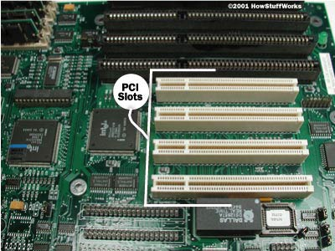
PCI Bus-Peripheral Component Interconnect
Intel released to public domain-32 bit and 64 bit versions
Plug and play facility.
PCI bus connects the CPU and expansion boards
Examples of PCI devices
Modem
Network Card
Sound Card,Video Card,etc

Slide 45
PCI Bus-Peripheral Component Interconnect
Coupling of the processor and expansion bus by means of a bridge
• 32-bit standard bus width with a maximum transfer rate of 133 Mbytes/s
• expansion to 64 bits with a maximum transfer rate of 266 Mbytes/s, – PCI-64/66 532 Mbytes/s,PCI-X 64/133 1064 Mbytes/s
• supporting of multi-processor systems
• burst transfers with arbitrary length
• supporting of 5 V and 3.3 V power supplies

Slide 46
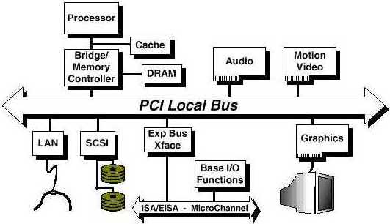
PCI Bus Lines (required)
Systems lines
Including clock and reset
Address & Data
32 time mux lines for address/data
Interrupt & validate lines
Interface Control
Arbitration
Not shared
Direct connection to PCI
bus arbiter
Error lines

Slide 47
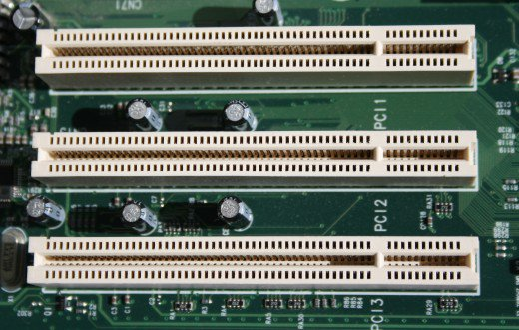
PCI Bus Lines (Optional)
Interrupt lines
Not shared
Cache support
64-bit Bus Extension
Additional 32 lines
Time multiplexed
2 lines to enable devices to agree to use 64-bit transfer

Slide 48
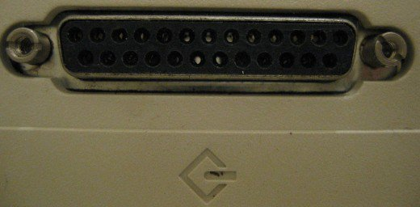
SCSI-Small Computer System Interface
Set of standard electronic interfaces that allow personal computers PC’s to communicate with peripheral hardware such as disk drives,tapes,CDs,Printers,scanners,etc
Commonly used for hard disk drives and tape.
Faster and more Flexibilty.
SCSI standards are generally backward compatible
SCSI interfaces have been replaced, for the most part, by Universal Serial Bus (USB)

Slide 49
SCSI-Small Computer System Interface
It allows you to add up to 15 peripheral devices.
SCSI is widely used in workstations, servers, and mainframes; it is less commonly used in desktop PCs.

Slide 50
SCSI-Small Computer System Interface
3 versions
8 bit 5 MB/s
16 bit 320 MB/s
32 bit 640 MB/s

Slide 51
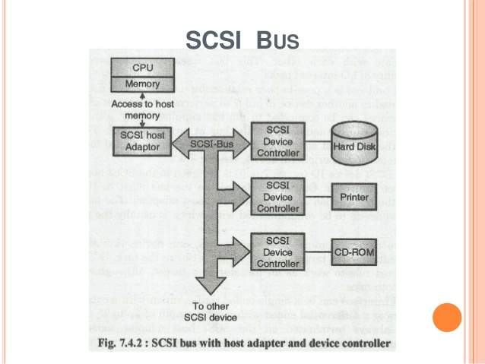

Slide 52
